Slide 1
IRPA 13: Refresher Course RC 19
Emergency Management According to New IAEA BSS
Elena Buglova
Head, Incident and Emergency Centre

Slide 2
IAEA Safety Standards: Hierarchy
Safety Fundamentals
Safety Requirements
Safety Guides

Slide 3
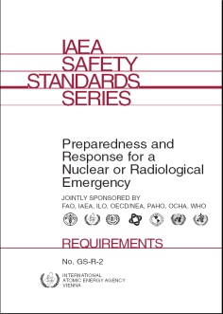
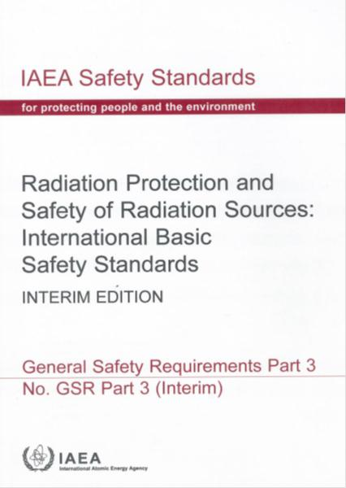
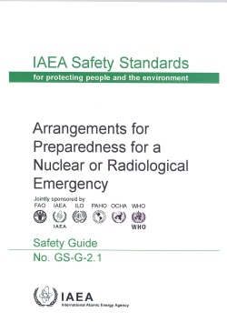
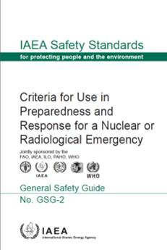
Safety Requirements and Guides in Area of Emergency Preparedness and Response (EPR)

Slide 4
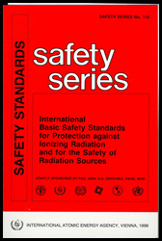
BSS 1996: Why Changes in EPR Area Were Needed? (1)
BSS 1996 did not address
  all emergency response actions e.g. decontamination or medical management / follow up
  internal exposure
  fetus – pregnant women
Criteria for severe deterministic effects – not adequate
Inconsistency in terms
  Generic Intervention Levels, Operational Intervention Levels, Generic Action Levels

Slide 5
BSS 1996: Why Changes in EPR Area Were Needed? (2)
Need for consistency with ICRP Publications
  ICRP 103 – Main recommendations – replacing ICRP 60
  ICRP 109 – addressing EPR in early phase
Lessons learned from response to past emergencies and from exercises

Slide 6
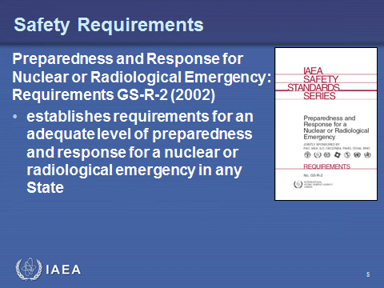
Approach in Revising EPR Area of BSS 1996
Text to be kept to a minimum, consistent with need for completeness of the BSS, with referencing to GS-R-2
Notes:
6

Slide 7
Changes From BSS 1996:
Restructuring text
  combining BSS 1996 Principal Requirements for Intervention and Appendix V Emergency Exposure Situations into one Section 4 “Emergency Exposure Situations”
Deleting certain parts fully covered in GS-R-2
Notes:
7

Slide 8
Walk Through Section 4, Schedule IV and Annex - Covering EPR Area

Slide 9
Section 4
Emergency Exposure Situations (1)
Scope:
The requirements for emergency exposure situations given in this section apply to activities undertaken in preparedness for and in response to a nuclear or radiological emergency

Slide 10
Section 4
Emergency Exposure Situations (2)
Generic Requirements: Requirement 43
Public Exposure: Requirement 44
Exposure of Emergency
Workers: Requirement 45
Transition from an
Emergency Exposure
to an Existing Exposure
Situation: Requirement 46
Notes:
10

Slide 11
Generic Requirements
Requirement 43: Emergency management system
The government shall ensure that an integrated and coordinated emergency management system is established and maintained

Slide 12
Essential Elements Of Emergency Management System (1)
Hazard assessment
Emergency plans and procedures
Allocation of responsibilities
  persons and organizations
Cooperation and coordination
Communication and public information
Optimized protection strategies

Slide 13
Essential Elements Of Emergency Management System (2)
Emergency workers protection
Education and training
Provisions for transition to existing exposure situation
Arrangements for medical response
Provisions for individual and environmental monitoring
Involvement of relevant parties and interested parties

Slide 14
Public Exposure
Requirement 44: Preparedness and response to an emergency
The government shall ensure that protection strategies are developed, justified and optimized at the planning stage, and that the response in an emergency is undertaken through their timely implementation.

Slide 16
Dosimetric Concepts and Their Application In Emergency Exposure Situations (1)
Residual dose - dose expected to be incurred in the future after protective actions have been terminated (or a decision has been taken not to implement protective actions)
Projected dose - dose that would be expected to be received if planned protective actions were not taken

Slide 17
Dosimetric Concepts and Their Application In Emergency Exposure Situations (2)
Averted dose - dose expected to be avoided through implementation of planned protective actions
  In general, refers to implementation of individual protective actions, but may, if specified, refer to dose avoided from implementation of several protective actions
Notes:
‘projected dose’ - dose expected to be received in the absence of planned protective measures
‘residual dose’ = projected doses – averted dose; dose expected to be received or measured/assessed following implementation of planned protection strategy
‘averted dose’ - dose expected to be avoided through the implementation of planned protective actions
In general, refers to the implementation of individual protective actions, but may, if specified, refer to the dose avoided from the implementation of several protective actions
dose that has been received
In the planning stage falls under the definition of the residual dose (the dose expected to be incurred in the future (projected dose) after protective actions have been implemented and terminated)
In an actual situation, is the actual dose received via all exposure pathways

Slide 18
Dosimetric Concepts and Their Application In Emergency Exposure Situations (3)
Dose that has been received
  At planning stage falls under definition of residual dose
  In an actual situation, is actual dose received via all exposure pathways (after protective actions have been fully implemented or a decision has been taken not to implement any protective actions)
Notes:
‘projected dose’ - dose expected to be received in the absence of planned protective measures
‘residual dose’ = projected doses – averted dose; dose expected to be received or measured/assessed following implementation of planned protection strategy
‘averted dose’ - dose expected to be avoided through the implementation of planned protective actions
In general, refers to the implementation of individual protective actions, but may, if specified, refer to the dose avoided from the implementation of several protective actions
dose that has been received
In the planning stage falls under the definition of the residual dose (the dose expected to be incurred in the future (projected dose) after protective actions have been implemented and terminated)
In an actual situation, is the actual dose received via all exposure pathways

Slide 19
Developing Strategy of Response to Emergency (1)

Slide 20
Generic Criteria for Protective Actions
Notes:
Slide provides a set of generic criteria for use within the protection strategy and are based on reference levels equal to 100 mSv and further details for specific actions in different timeframes.
IAEA Training in Emergency Preparedness and Response
20

Slide 21
Developing Strategy of Response to Emergency (2)
Notes:
IAEA Training in Emergency Preparedness and Response
21

Slide 22
Schedule IV
Criteria for Use in Emergency Preparedness and Response
Table IV-1: Generic criteria for acute doses at which protective and other actions are expected to be undertaken under any circumstances to avoid or to minimize severe deterministic effects
(GSR Part 3, p. 92)

Slide 23
Generic Criteria for Preventing Severe Deterministic Effects (1)
Acute external, local and contact exposure
Organ or tissue | RBE-weighted dose
Red marrow | 1 Gy
Foetus | 0.1 Gy
Soft tissue | 25 Gy at 0.5 cm to 100 cm²
Skin derma | 10 Gy at 0.4 mm to 100 cm²
Notes:
(Table 2 of GSG-2)
Table gives generic criteria (expressed in the terms of dose that is projected to be received or dose that has been received) for taking precautionary urgent protective actions under any circumstances to prevent severe deterministic health effects. It summarizes generic criteria are established at the level of doses which are approaching thresholds for severe deterministic health effects in case of external exposure.
Dose in Red marrow represents the average RBE-weighted dose to internal organs (e.g., red marrow, lung, small intestine, gonads, thyroid, etc.) and lens of eye from irradiation in a uniform field of strongly penetrating radiation.
Dose in soft tissue reflects RBE-weighed dose delivered at the depth of 0.5 cm under the body surface in tissue due to close contact with a radioactive source (e.g. source carried in hand or pocket).
Dose in skin reflects RBE-weighed dose to the area of 100 cm² of derma (skin structures at a depth of 50 mg/cm² (or 0.5 mm) under the surface).
Slide presents generic criteria (expressed in the terms of dose that is projected to be received or dose that has been received) for taking precautionary urgent protective actions under any circumstances to prevent severe deterministic health effects.
In the case of combined internal and external exposure, the sum of the RBE-weighted doses in certain organ for intake of radioactive material and for external exposure may be used as a basis for calculation of OILs for decision making purposes.

Slide 24
Generic Criteria for Preventing Severe Deterministic Effects (2)
Acute intake
Organ or tissue | 30-day committed RBE-weighted dose
Red marrow | 0.2 Gy [RN with Z>89]; 2 Gy [other]
Thyroid | 2 Gy [thyroid seeking RN]
Lung | 30 Gy
Colon | 20 Gy
Foetus | 0.1 Gy
Notes:
(Table 2 of GSG-2)
Table gives generic criteria (expressed in the terms of dose that is projected to be received or dose that has been received) for taking precautionary urgent protective actions under any circumstances to prevent severe deterministic health effects. It summarizes generic criteria are established at the level of doses which are approaching thresholds for severe deterministic health effects in case of intake of radionuclides.
30-day committed RBE-weighted dose is the RBE-weighted absorbed dose delivered over the period of 30 days by the intake that will result in a severe deterministic effects in 5% of exposed people.
In case of internal exposure of red marrow, different criteria are used to account for the significant difference in the radionuclide specific intake threshold values for the radionuclide in these groups which are characterized by different biokinetic in human skeleton.
For purposes of this document "Lung" means the Alveolar-interstitial region of the respiratory tract.
For particular case of exposure of foetal the committed RBE-weighted dose defined for a period of in utero development.
In the case of combined internal and external exposure, the sum of the RBE-weighted doses in certain organ for intake of radioactive material and for external exposure may be used as a basis for calculation of OILs for decision making purposes.

Slide 25
Annex
Generic Criteria for Protective Actions and other Response Actions in Emergency Exposure Situations to Reduce the Risk of Stochastic Effects
  Table A-1: Generic criteria for protective actions and other response actions in emergency exposure situations to reduce the risk of stochastic effects
  (GSR Part 3, p. 97)

Slide 26
Generic Criteria for Reducing Risk of Stochastic Effects (1)
Dosimetric quantity | Projected dose in the first week and urgent protective actions
Total effective dose | 100 mSv | Sheltering, evacuation, decontamination, restriction of food consumption, etc
Total equivalent dose in foetus or embryo | 100 mSv
Committed equivalent dose in thyroid | 50 mSv | Iodine thyroid blocking
Notes:
IAEA Training in Emergency Preparedness and Response
26
(Table 3 of GSG-2)
The slide provides a set of generic criteria from Table 3 of GSG-2 expressed in the terms of dose that has been projected or received. The set of generic criteria expressed in the terms of projected dose is based on a reference level of 100 mSv. Taking protective actions at this level allow to avoid the occurrence of all deterministic health effects and to reduce the risk of stochastic health effects to acceptable levels. If a protective action is implemented effectively, the majority of the projected dose can be averted. Therefore, for the assessment of efficiency for the individual protective actions or their combination, the concept of averted dose is useful. It represents an important component of the optimization of emergency response planning. In application of generic criteria for individual protective actions the optimization process should be applied.

Slide 27
Generic Criteria for Reducing Risk of Stochastic Effects (2)
Dosimetric quantity | Projected dose in the first year and early protective actions
Total effective dose | 100 mSv | Temporary relocation, decontamination, replacement of food, milk and water, public reassurance, etc
Total equivalent dose in foetus or embryo (for period of in utero development) | 100 mSv
Notes:
IAEA Training in Emergency Preparedness and Response
27
(Table 3 of GSG-2)
The slide provides a set of generic criteria from Table 3 of GSG-2 expressed in the terms of dose that has been projected or received. The set of generic criteria expressed in the terms of projected dose is based on a reference level of 100 mSv. Taking protective actions at this level allow to avoid the occurrence of all deterministic health effects and to reduce the risk of stochastic health effects to acceptable levels. If a protective action is implemented effectively, the majority of the projected dose can be averted. Therefore, for the assessment of efficiency for the individual protective actions or their combination, the concept of averted dose is useful. It represents an important component of the optimization of emergency response planning. In application of generic criteria for individual protective actions the optimization process should be applied.

Slide 28
Exposure of Emergency Workers
Requirement 45: Arrangements for controlling exposure of emergency workers
The government shall establish a programme for managing, controlling and recording doses received in an emergency by emergency workers, which shall be implemented by response organizations and employers

Slide 29
Emergency Worker - Definition
Any person having a specified role as a worker in an emergency and who might be exposed while taking actions in response to the emergency
Notes:
Emergency workers who undertake actions in which the dose received might exceed the single year dose limit for occupational exposure should do so voluntarily, should have been clearly and comprehensively informed in advance of the associated health risk, and should be trained, to the extent feasible, in the actions that may be required.
Response organizations and employers shall ensure that emergency workers who undertake actions in which the dose received might exceed 50 mSv do so voluntarily, and have been clearly and comprehensively informed in advance of the associated health risk, as well as of available protection measures, and are, to the extent feasible, trained in the actions that may be required. The voluntary basis for response actions by emergency workers is usually covered in the emergency response arrangements.
In the exceptional circumstances given in the next slide response organizations and employers shall make all reasonable efforts to keep doses to emergency workers, below the values set out in the next slide. In addition, emergency workers undertaking actions in which their doses may approach or exceed the values set out in the next slide shall do so only when the benefits to others clearly outweigh their own risk.

Slide 30
Emergency Workers
May include those employed by registrants and licensees as well as personnel from response organizations
  Police officers
  Firefighters
  Medical personnel, and
  Drivers and crews of evacuation vehicles
Notes:
Emergency workers who undertake actions in which the dose received might exceed the single year dose limit for occupational exposure should do so voluntarily, should have been clearly and comprehensively informed in advance of the associated health risk, and should be trained, to the extent feasible, in the actions that may be required.
Response organizations and employers shall ensure that emergency workers who undertake actions in which the dose received might exceed 50 mSv do so voluntarily, and have been clearly and comprehensively informed in advance of the associated health risk, as well as of available protection measures, and are, to the extent feasible, trained in the actions that may be required. The voluntary basis for response actions by emergency workers is usually covered in the emergency response arrangements.
In the exceptional circumstances given in the next slide response organizations and employers shall make all reasonable efforts to keep doses to emergency workers, below the values set out in the next slide. In addition, emergency workers undertaking actions in which their doses may approach or exceed the values set out in the next slide shall do so only when the benefits to others clearly outweigh their own risk.

Slide 31
Exposure of Emergency Workers
Relevant requirements for occupational exposure in planned exposure situations in accordance with a graded approach shall apply
Response organizations and employers shall ensure that no emergency worker is subject to an exposure in an emergency in excess of 50 mSv other than those who perform exceptional tasks
Notes:
IAEA Training in Emergency Preparedness and Response
31
Response organizations and employers shall take all reasonable steps to assess and record the doses received by emergency workers. The doses received and information concerning the consequent health risk shall be communicated to the workers involved.
Dosimeter results should be formally recorded and kept in compliance with regulatory requirements. These will specify the retention period (at least thirty years) and often the format. Dose records have the following purposes.
They verify compliance with regulatory requirements, showing that controls are used to keep doses as low as reasonably achievable and that guidance levels are not exceeded.
They allow response management to compare procedures and identify the best practical means of working which result in the lowest doses.
They aid the medical adviser's assessments and means of controlling detriment to an individual responder.
They provide long term medical and legal assurance for both emergency worker and employer in the event that the worker contracts a radiation linked disease in later life.
They supply data for epidemiological and other studies into the biological effects of ionizing radiation.
Dose records should contain the results of all special dosimetry including assessments of doses to individual organs. Each worker should have only one current dose record, which should be protected against loss or damage. When employment is terminated, a summary of doses received should be prepared that the worker may make available to a new employer, as appropriate.
Workshop on Expanded Response in Nuclear Emergencies
Module L-ER-7. Radiation Protection and Safety in Emergency Exposure Situation

Slide 32
Schedule IV of the GSR Part 3
Criteria for Use in Emergency Preparedness and Response
Table IV-2: Guidance values for restricting exposure of emergency workers
(GSR Part 3, p. 93)

Slide 33
Guidance Values for Restricting Exposure of Emergency Workers
Tasks | Guidance Value
Life saving actions | H_{P}(10) < 500 mSv*
Actions to prevent severe deterministic health effects Actions to prevent development of catastrophic conditions | H_{P}(10) < 500 mSv
Actions to avert a large collective dose | H_{P}(10) < 100 mSv
⁽*⁾ This value may be exceeded under the circumstances where the benefit to others clearly outweighs the emergency worker’s own risk and the emergency worker volunteers to take the action, and understands and accepts this risk

Slide 34
Response Organizations and Employers Shall Ensure
All reasonable efforts are taken to keep doses below values of Schedule IV
Emergency workers who undertake actions in which doses received might exceed 50 mSv
  Do so voluntarily
  Are clearly and comprehensively informed in advance of associated health risks and available protective measures
  Trained in actions they may be required to do

Slide 35
Response Organizations and Employers Shall Take Steps
To assess and record doses received by emergency workers
To communicate information (doses and associated health effects) to emergency workers

Slide 36
Further Occupational Exposure
Workers who received doses in emergency normally are not precluded from incurring further occupational exposure
If dose received exceeded 200 mSv or at request of worker, qualified medical advice shall be obtained before any further occupational exposure

Slide 37
Transition from Emergency to Existing Exposure Situation
Requirement 46: Arrangements for transition from an emergency exposure situation to an existing exposure situation
The government shall ensure that arrangements are put in place, and implemented as appropriate, for the transition from an emergency exposure situation to an existing exposure situation

Slide 38
Issues to Consider
Different geographical areas may undergo transition in different times
Responsible authority makes a decision
Transitional shall be made in a coordinated and orderly manner
Involvement of relevant authorities and interested parties

Slide 39
Summary: from SS-115 to GSR Part 3 (1)
Consistency with ICRP Recommendations
Arrangements for protection of public
  Strategies for protection based on reference levels and generic criteria for protective actions
    reference level of residual dose
    generic criteria of projected dose for protective actions to avoid/minimize severe deterministic effects
    generic criteria of projected dose for protective actions corresponding to the reference levels of residual dose to reduce risk of stochastic effects
    generic criteria of received dose for medical actions

Slide 40
Summary: from SS-115 to GSR Part 3 (2)
Arrangements for protection of emergency workers
  Definition of emergency workers – who are those included
  Graded approach for restricting exposure of emergency workers
Requirements on transition from emergency exposure situation to existing exposure situation

Slide 41
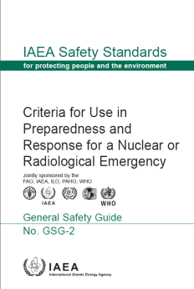
Safety Guides - Supporting Implementation
Criteria for Use in Planning Response to Nuclear and Radiological Emergencies:
General Safety Guide GSG-2 (2011)
Provides
  Generic criteria
  Operational intervention levels (OILs)
    Examples of default OILs for deposition, individual monitoring and food, milk and water contamination
  Emergency actions levels for LWRs
  On-scene observables
  Plain language explanation of actions vs OILs
Notes:
IAEA Training in Emergency Preparedness and Response
41

Slide 42
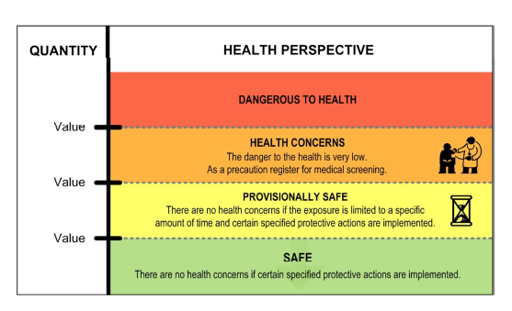
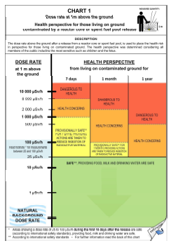
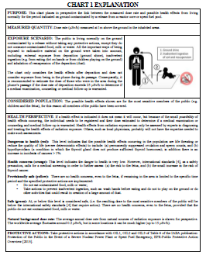
Supporting Guidelines
Technical documents under development
  Protection of the public in case of severe emergencies at nuclear power plants
    Specific emphasis on provision of plain language explanation to public
  Method for revision of Operational Intervention Levels (OILs)

Slide 43
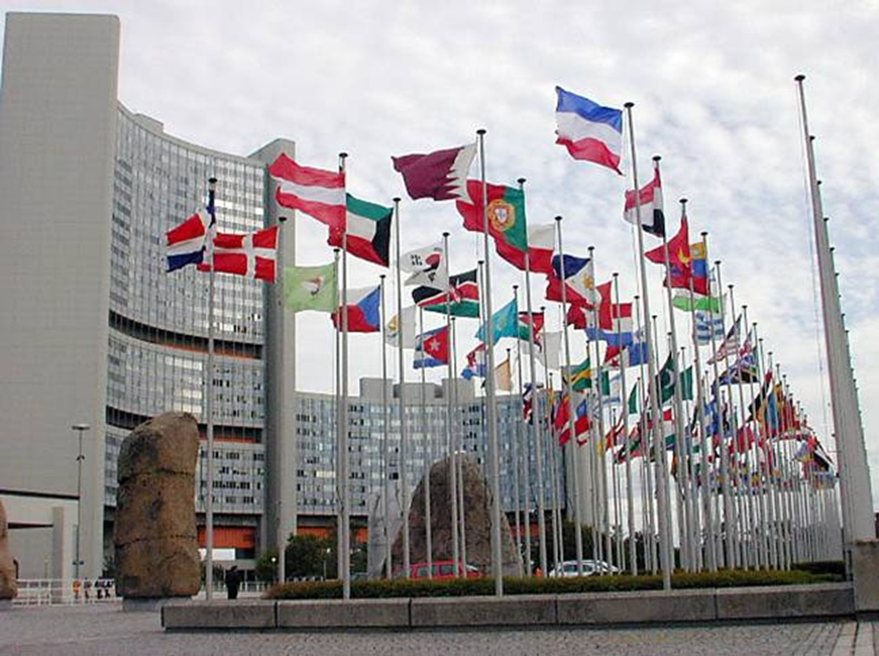
Thank You!
E.Buglova@iaea.org
Notes:
IAEA Training in Emergency Preparedness and Response
43

